Slide 1
Finding the Right Location for A yogurt BAR

Slide 2
Business PROBLEM
Greek Yogurt or yogurts, in general, are becoming very popular in some of India lately, but they have their challenges, they are packaged. You can't carry with you to the office of gyms as a snack as they need refrigeration, and also they are priced at a premium point. I am helping my friend to identify a couple of spots in Bangalore where he can start a Yogurt joint, which serves fresh Yogurt, Yogurt shakes, Frozen Yogurt, etc. This will mainly cater to the following segments of the population.
Gym goers who want a post work out snacks
Parents looking for replacement of ice cream and other sugar-heavy deserts for their kids
Office people who are into healthy snacking

Slide 3
Data DESCRIPTION
In order to leverage the four square data about venues in and around a particular geo-coordinates, we need to identify the geo-coordinates of prime areas in Bangalore. In search of this data, I looked at multiple sites. I happened to run into, Indian Govt site, which had data on various post offices in the city with address and geo-coordinates. This data becomes a starting point for us to get more information around various areas in the city. We have to clean this data to remove the rural areas or outskirt from our assessment as these are not targeted segment for our pilot run. Once we have the final set of places, we will leverage foursquare APIs and will find the areas with the maximum number of Gyms, Health clubs, Offices, and Schools in 5 Km radius. We will assign a weight to different venues and will use the total score for a segment to identify the best place to start with.
To keep the areas that are pertinent, we found out the geocode of bangalore and removed all the areas that were more than 25 Kms away from bangalore. By doing this, we limited our data to urban areas of Bangalore. Areas that are most relevant to our project.

Slide 4
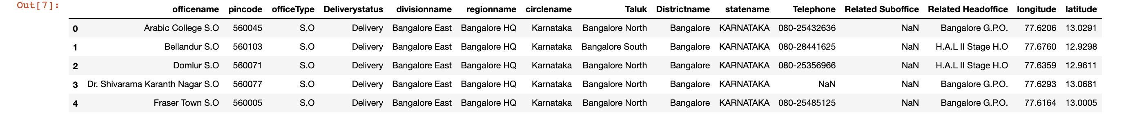
RAW DATA

Slide 5
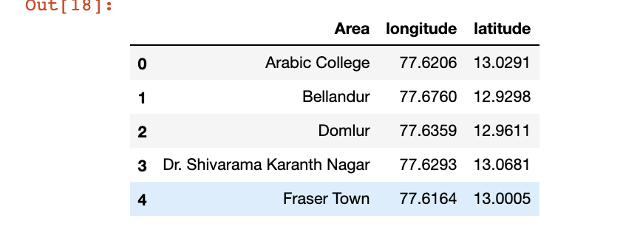
Cleaned DATA

Slide 6
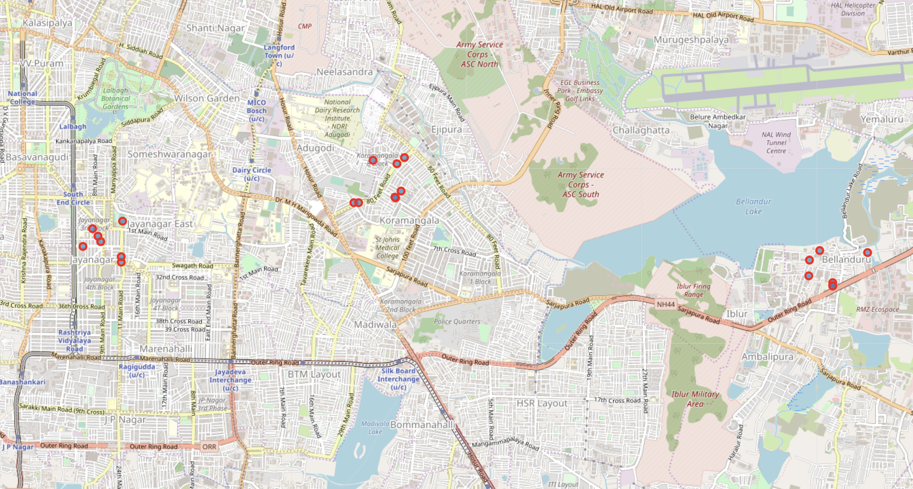
TOP THREE Segmented AREAS

Slide 7
CONCLUSION
After performing the assessment on data returned by four square, we found that in the following 4 areas, the chances of finding the potential consumer are maximum, and hence we should start the first yogurt shop in one of these areas.
Koramangala VI Bk 8
Jayangar III Block 7
Bellandur 7
H.A.L II Stage H.O 4

